Slide 1

Analysis for Best Cities to Live in California
Sudip , Tamasree & Hima

Slide 2

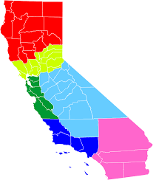

About the Project.
California is widely regarded as the coolest state in the United States. The tech capital of the world, Silicon Valley, and there’s just about everything. It is one of the few places in the world where you can go from skiing to surfing, to sand-boarding in the desert – all on the same day.
It’s a little wonder everyone wants to move here, and in actual fact, this happens to be the most populous state – and state with the largest economy in the U.S

Slide 3
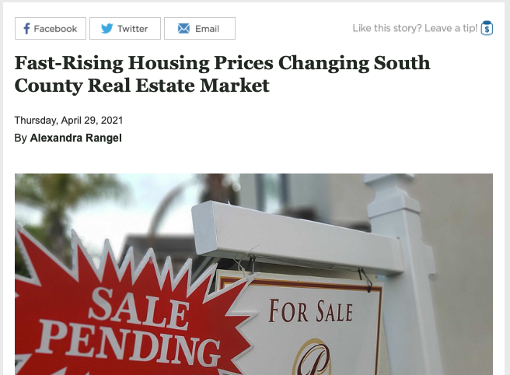
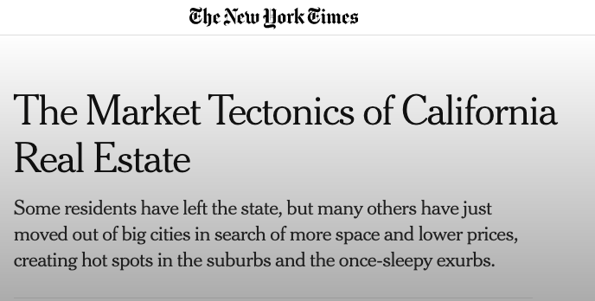

Motivation

Slide 4
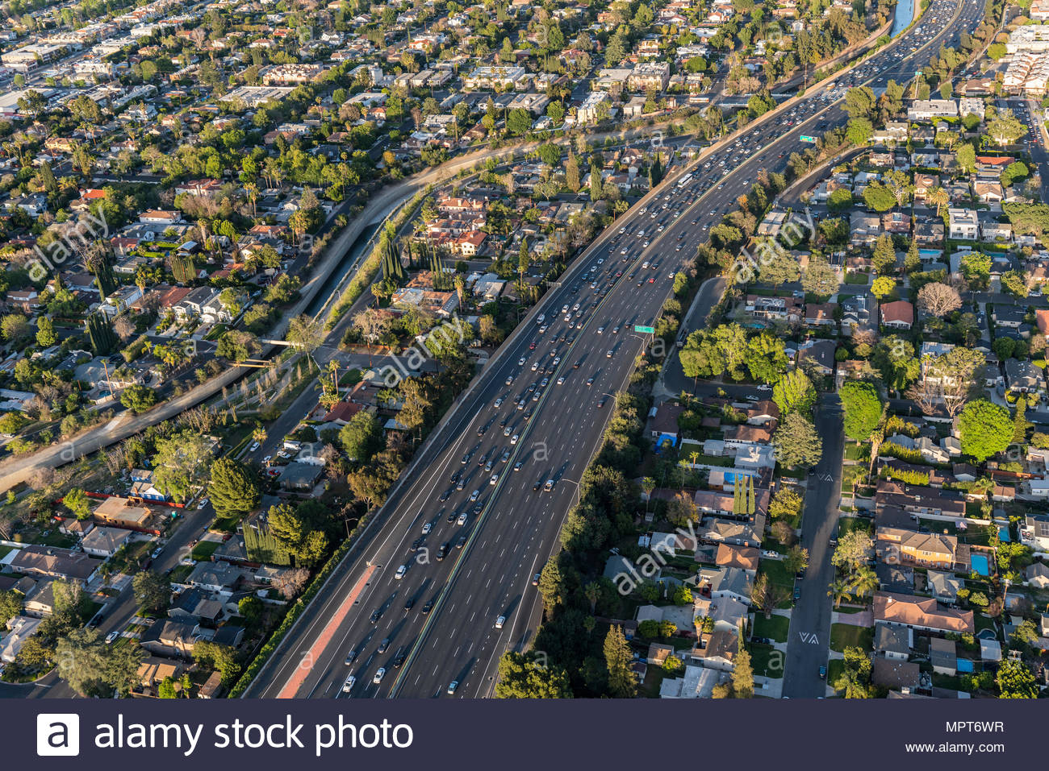
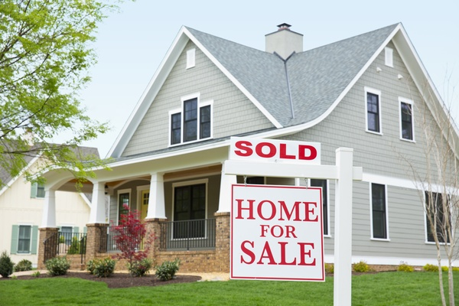
Need for analysis..
1. Understanding the Barriers of Affordable Housing
How Housing Prices related to other factors?
What effects the housing value much?
Understanding the housing price correlation between different terms.

Slide 5



Need for analysis..
2. Most Affordable 5 Cities of California
We chose to analyze most common factors:
House Value
Income
Cost/Rent
Poverty
Public Transport
Employment/unemployment rate

Slide 6

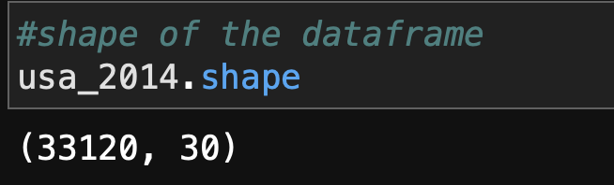
Approach
Collecting the Data
Downloaded 5 years of US Census data for every zip code
Rows: 33000
Columns: 28

Slide 7

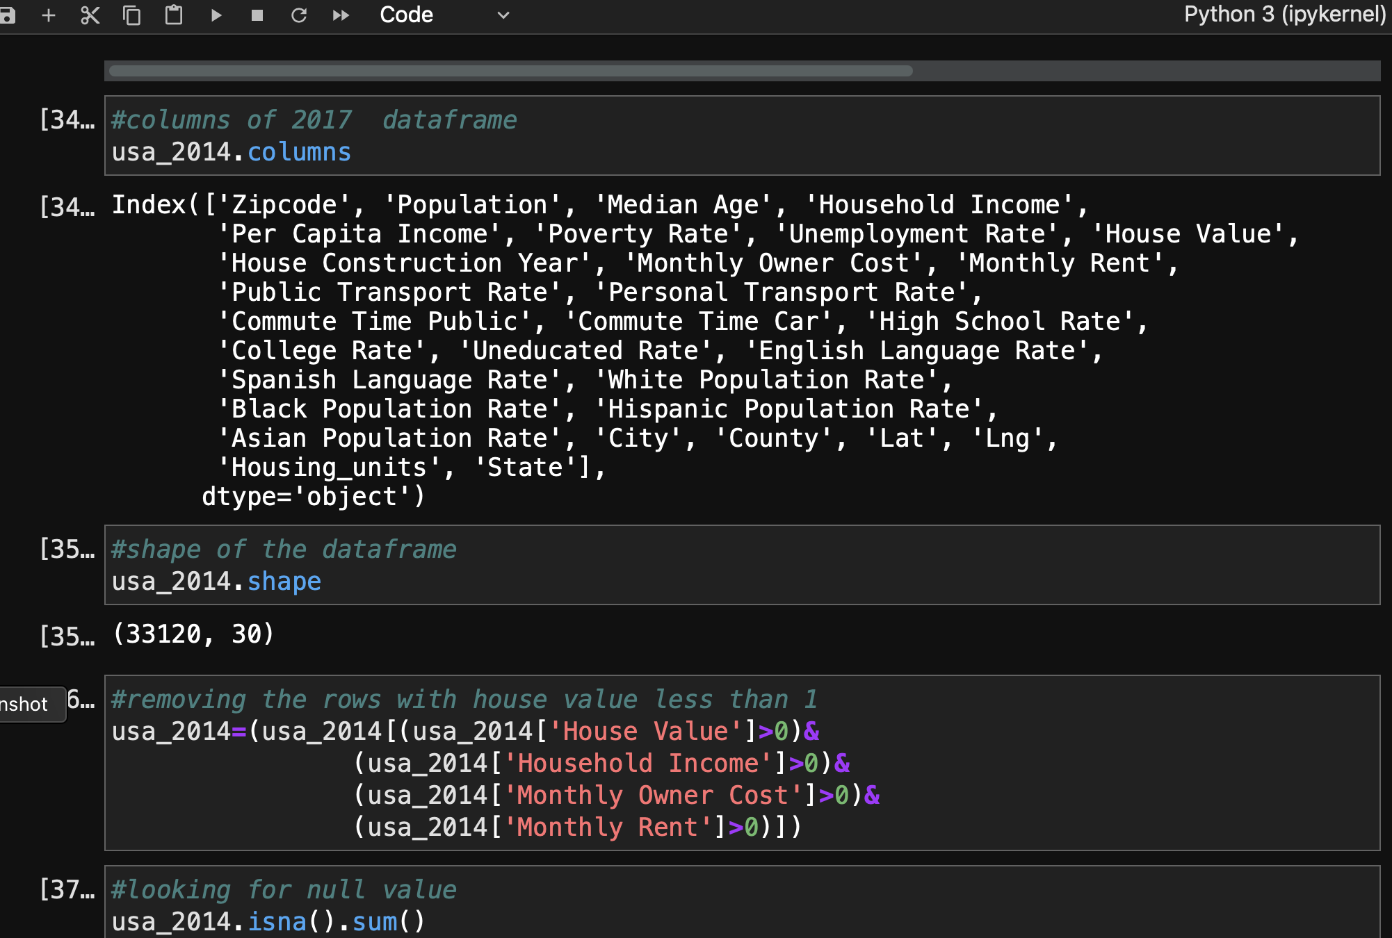
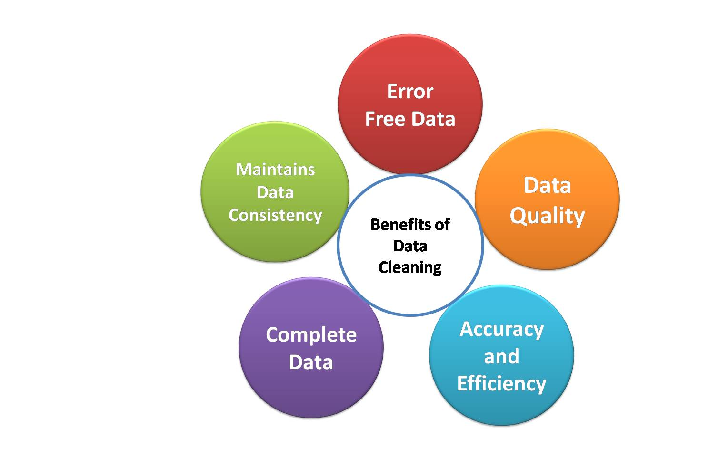

Slide 8
Data Analysis of CA State for 2019
'Household Income’, 'Poverty Rate', 'House Value’, 'Monthly Owner Cost’, 'Monthly Rent'
Economy
Education
Transportation
Race
'College Rate', 'Uneducated Rate’, 'High School Rate’, 'Housing units', 'Median Age'
'Public Transport Rate', 'Personal Transport Rate’, 'Commute Time Car'
'Asian Population Rate’, 'White Population Rate’, 'Hispanic Population Rate’, 'Black Population Rate'

Slide 9
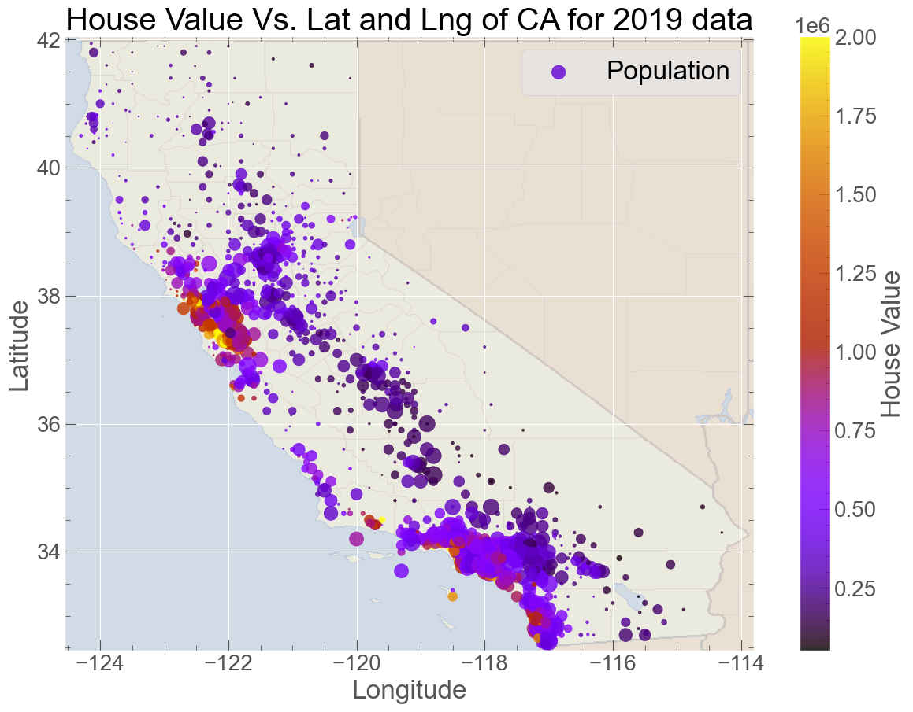
House Price

Slide 10
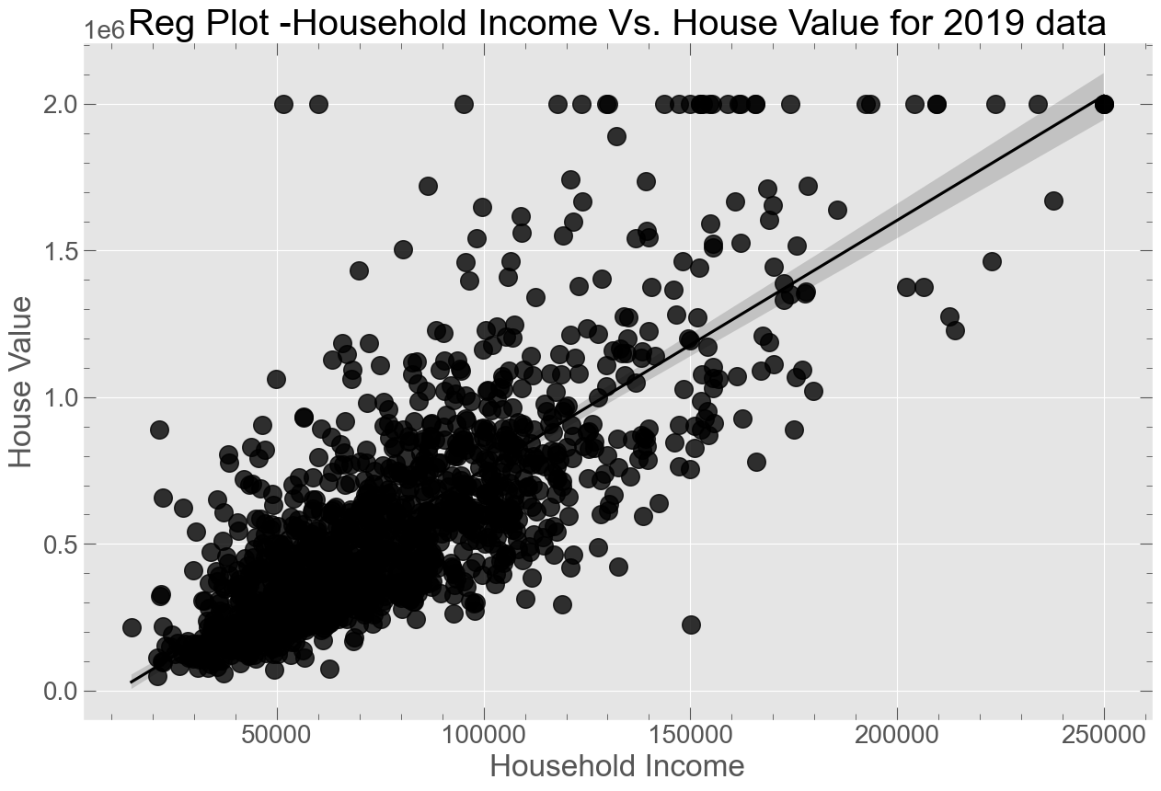
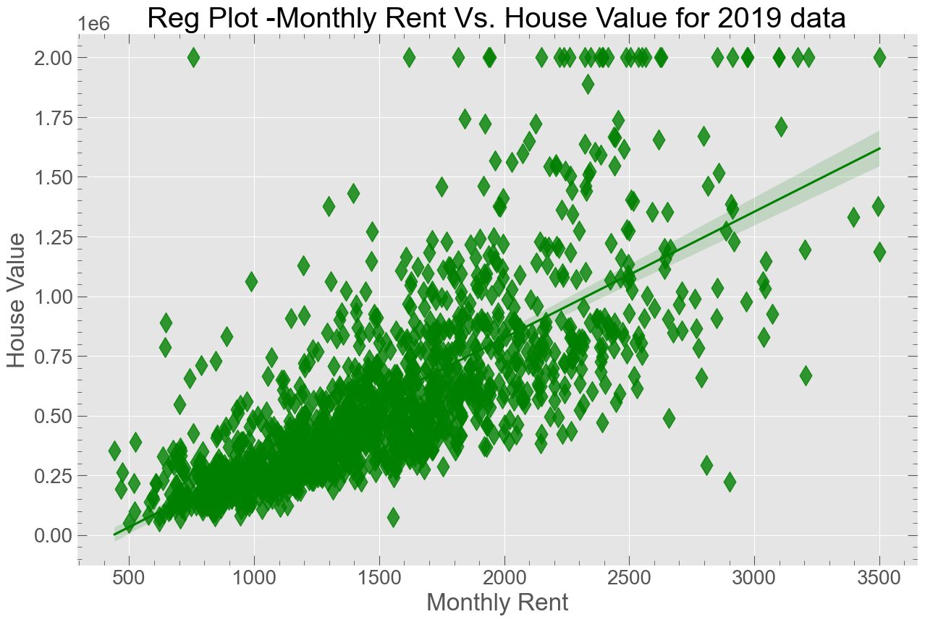
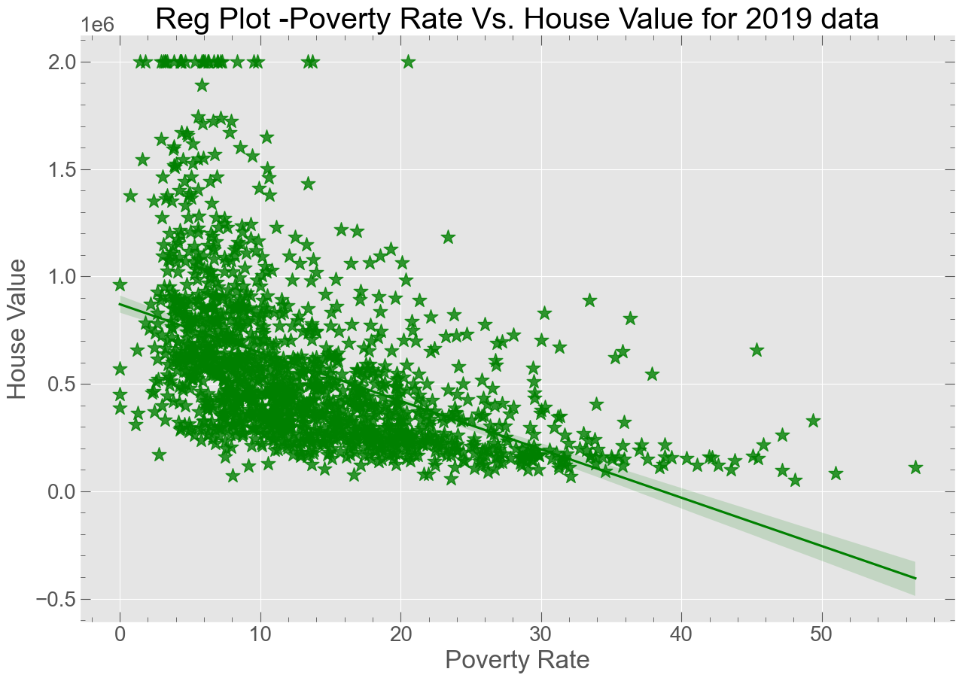
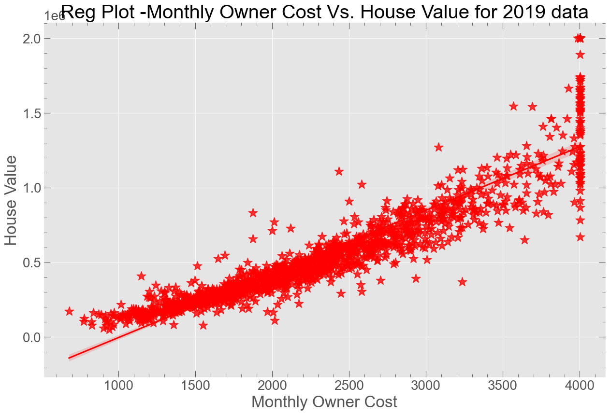
Economy

Slide 11
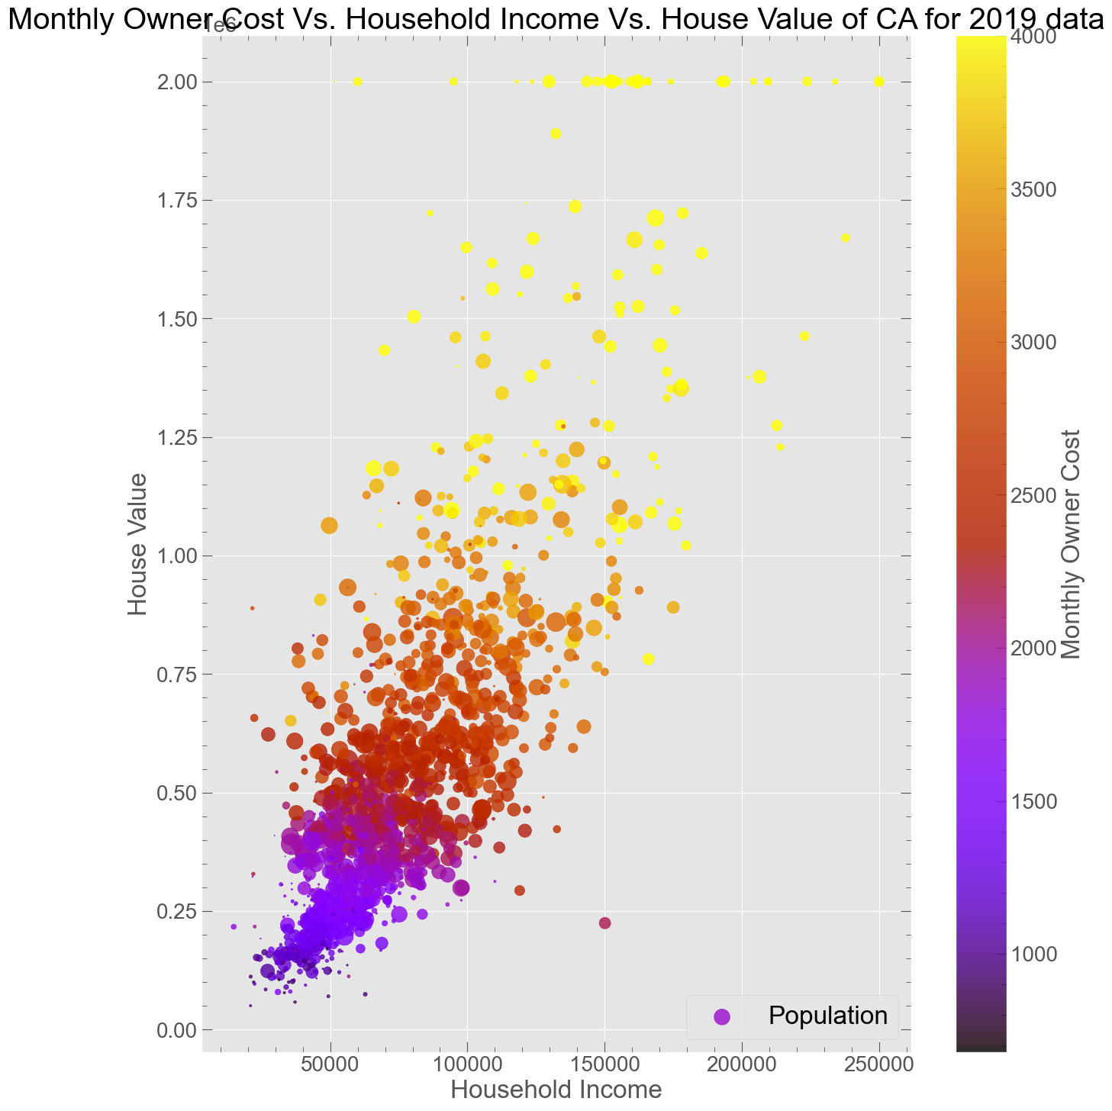
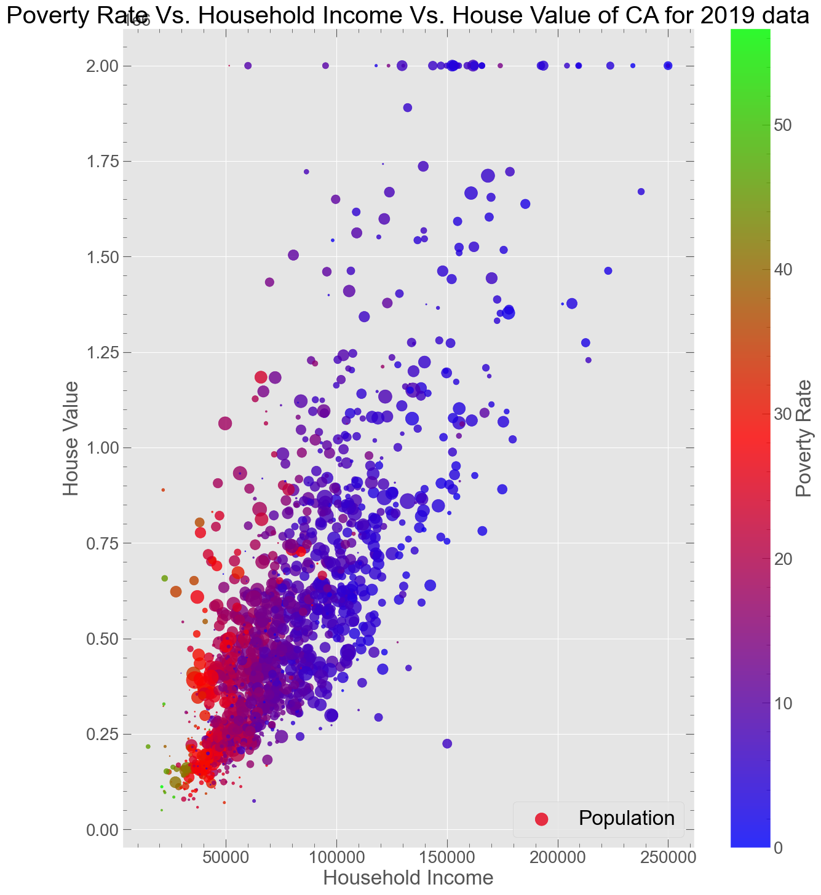

Slide 12
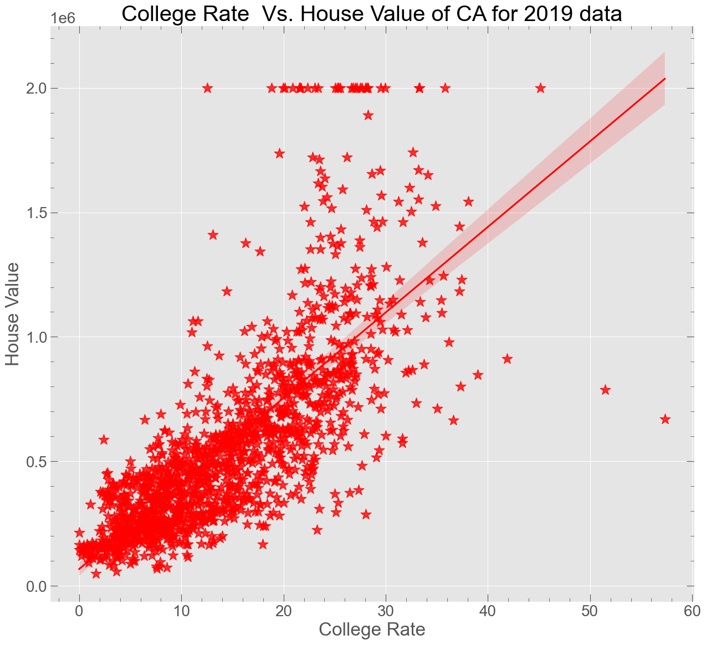
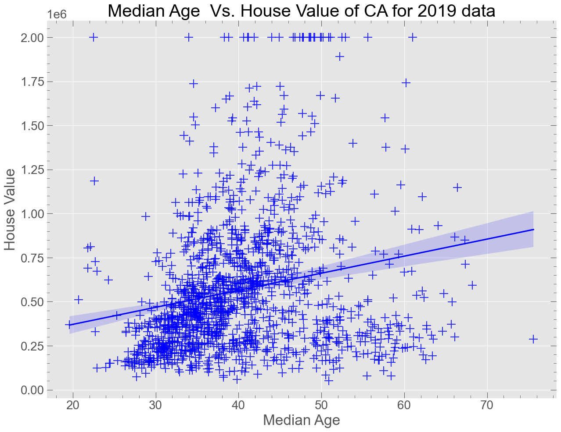
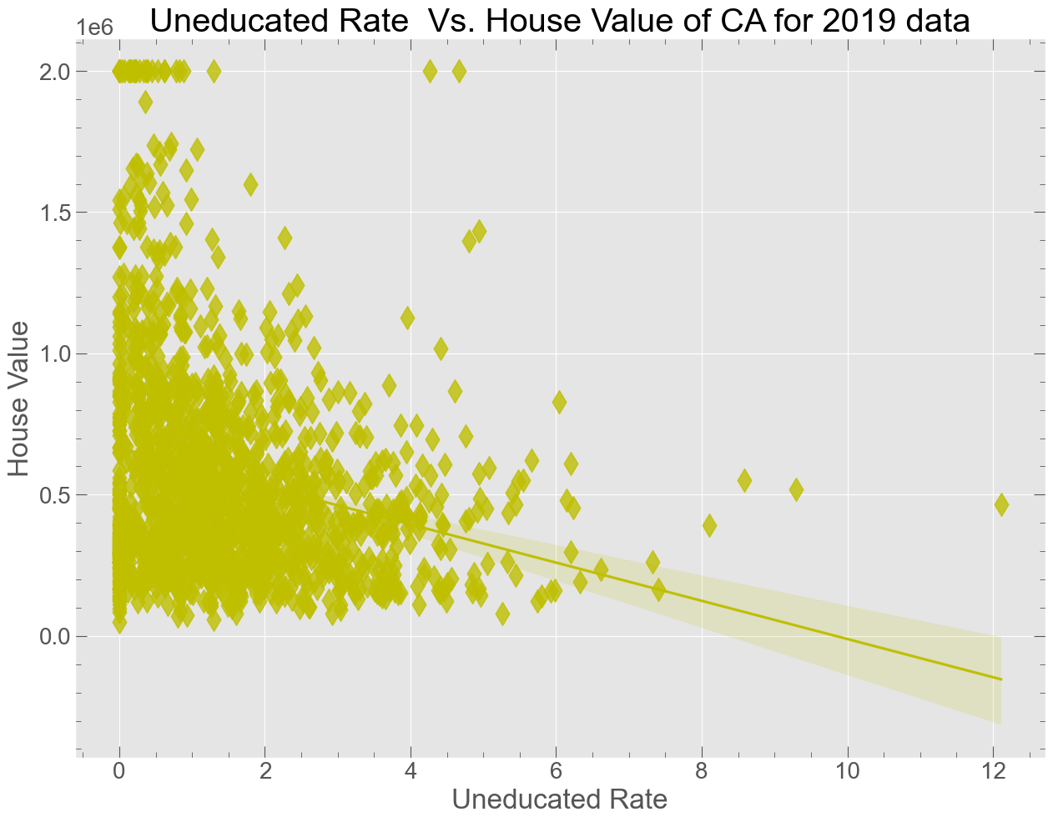
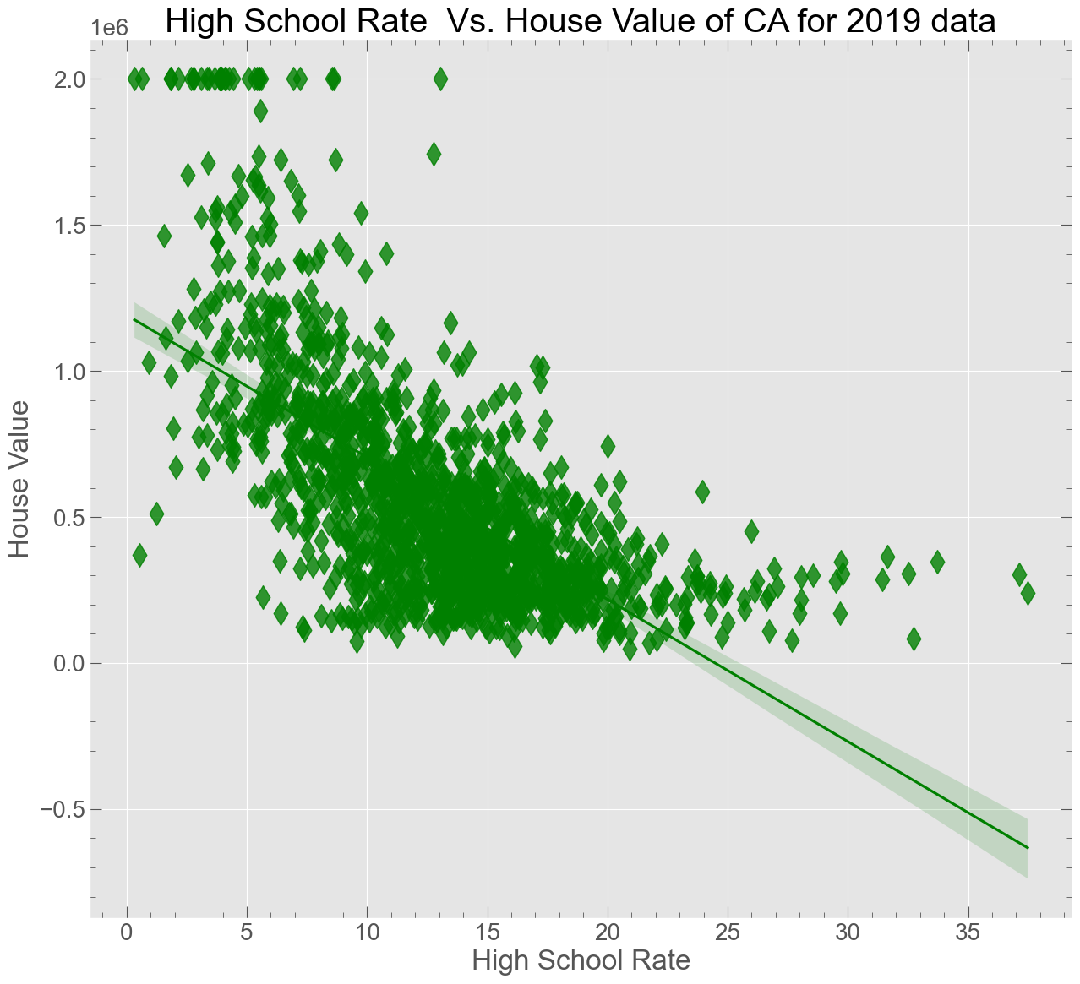
2. Education

Slide 13
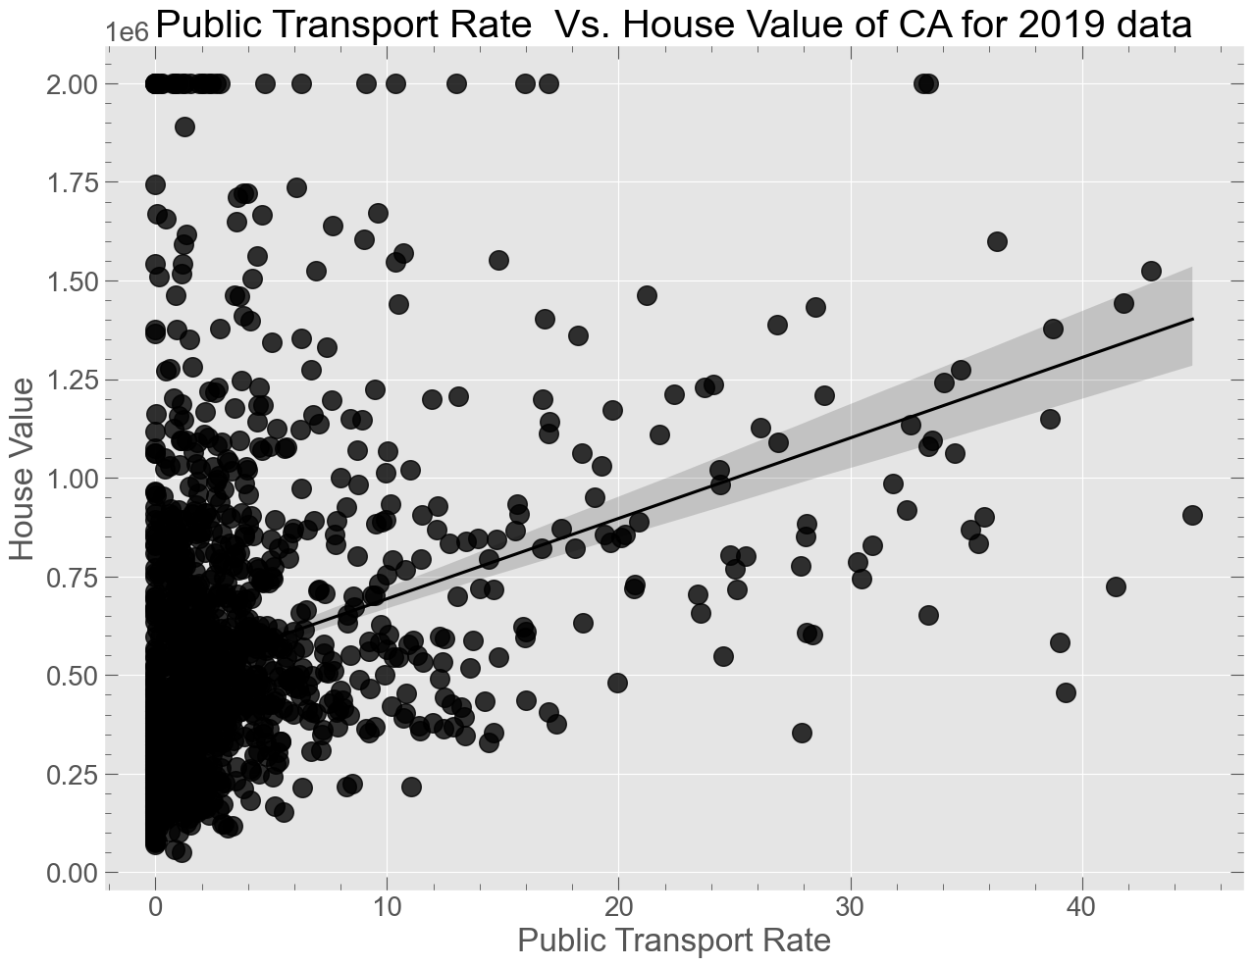
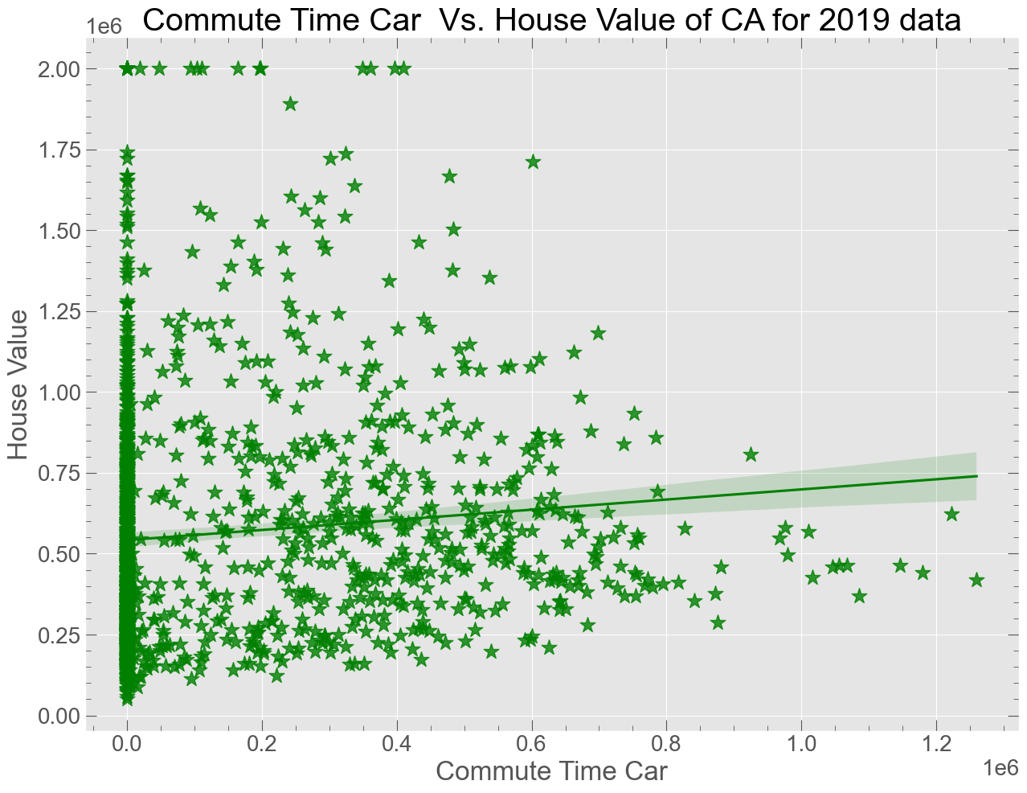
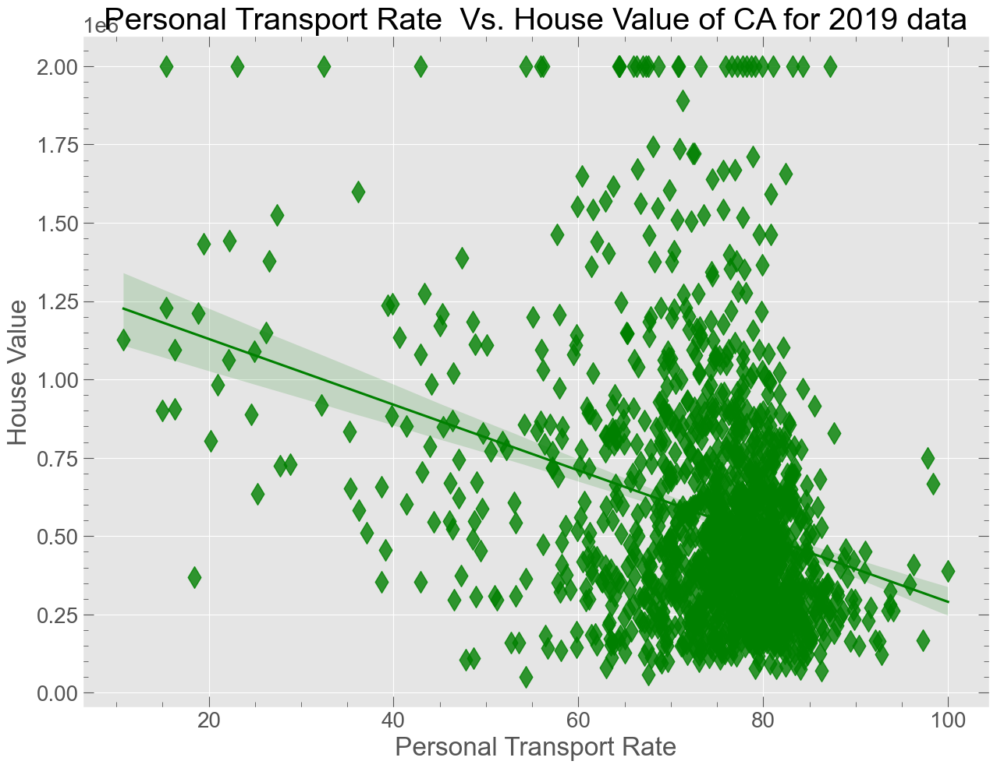
3. Transportation

Slide 14
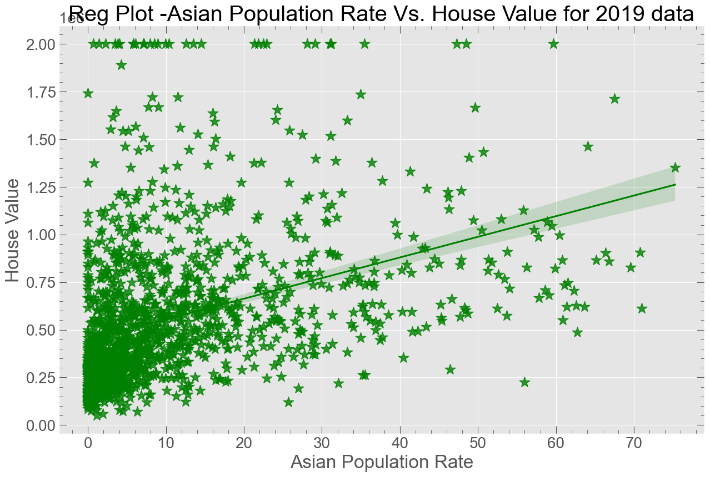
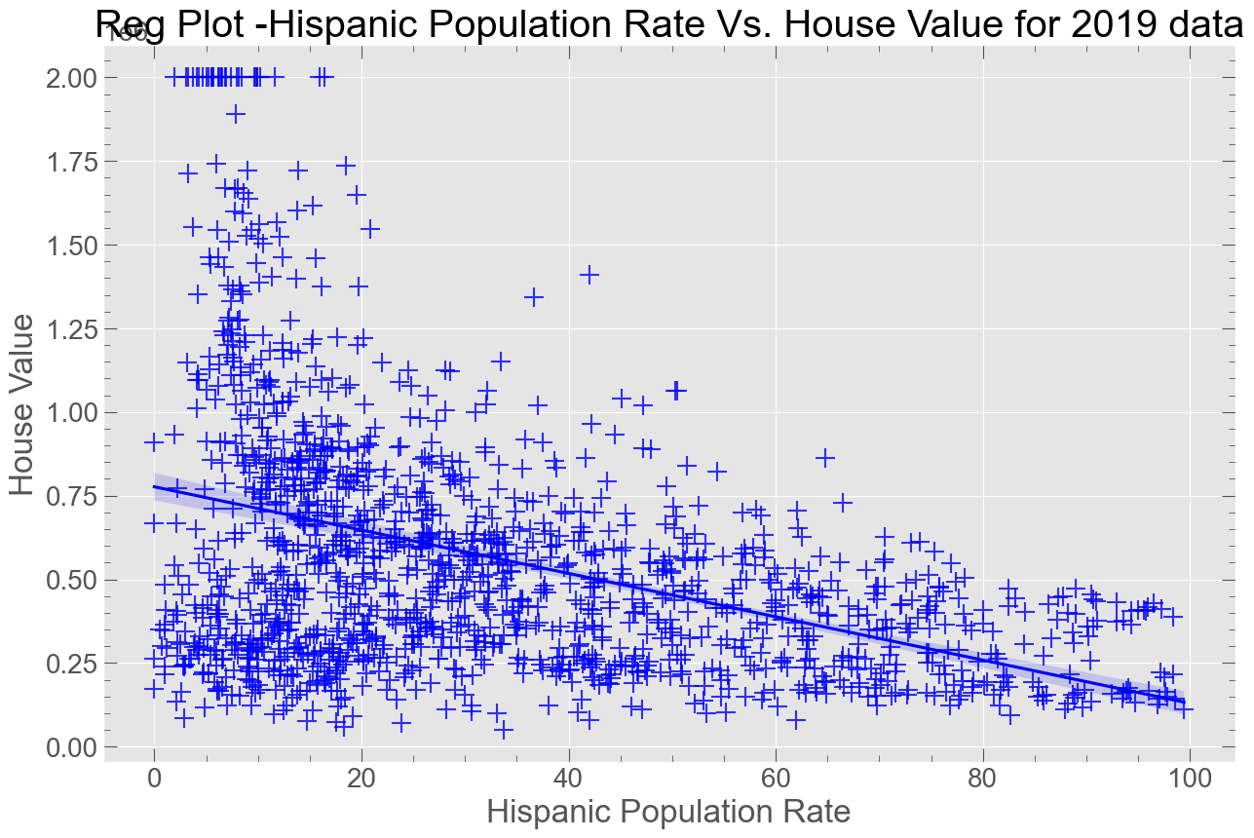
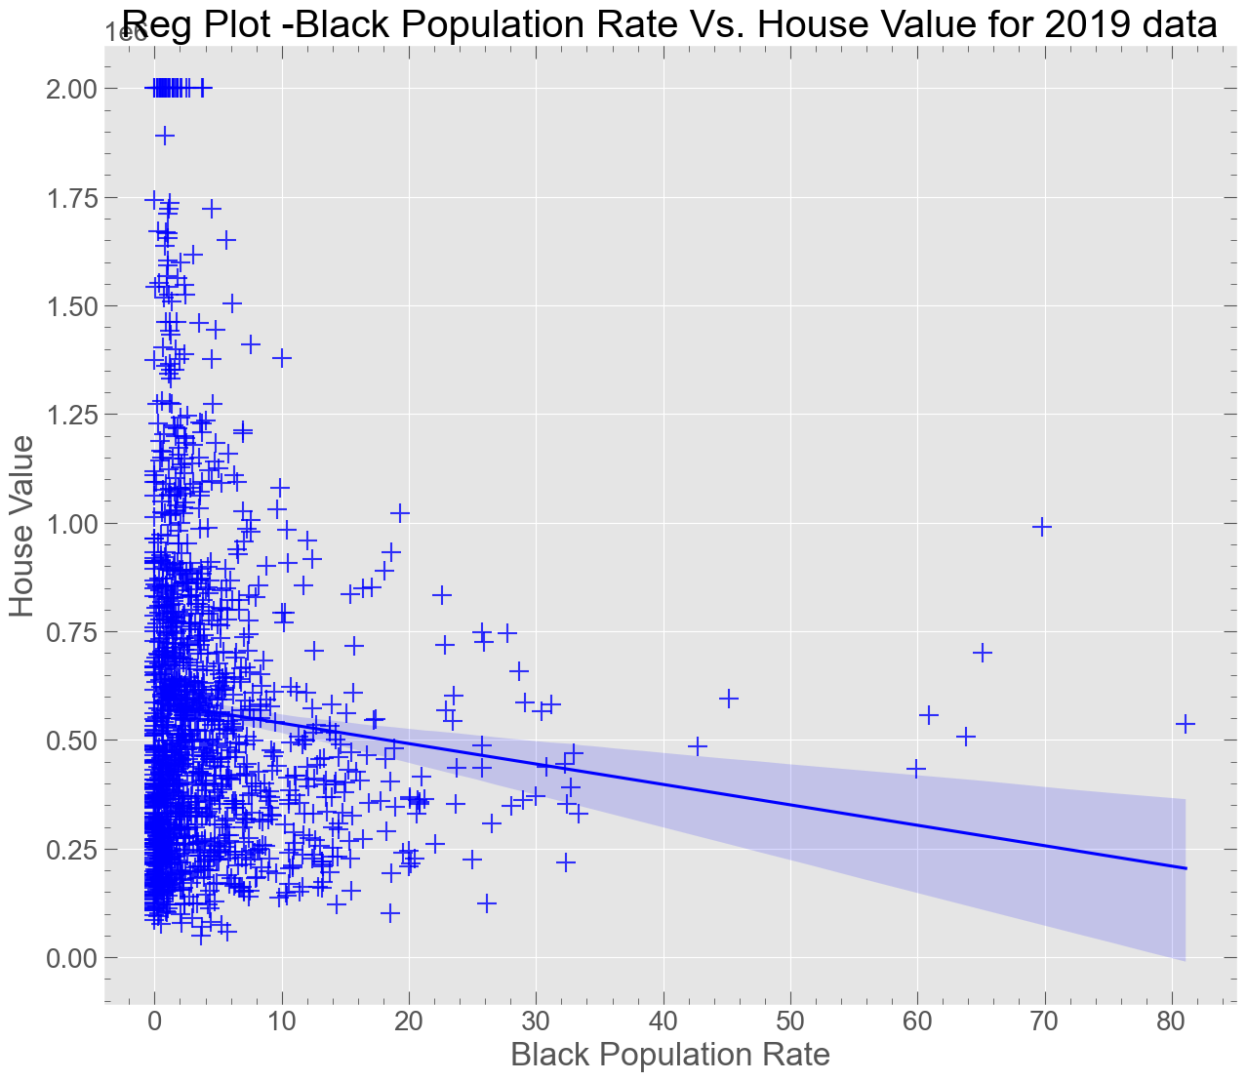
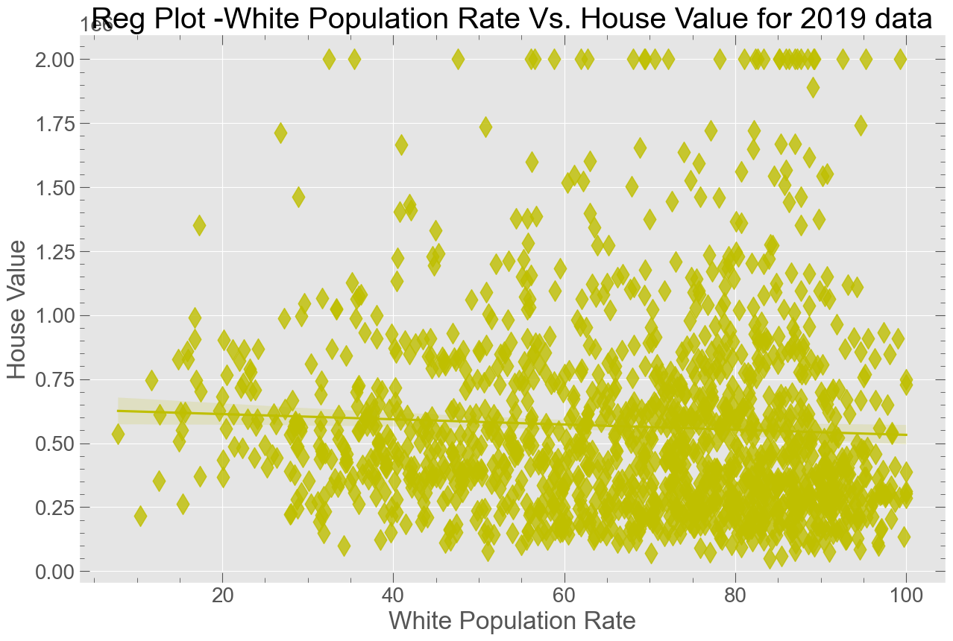
4. Race

Slide 15
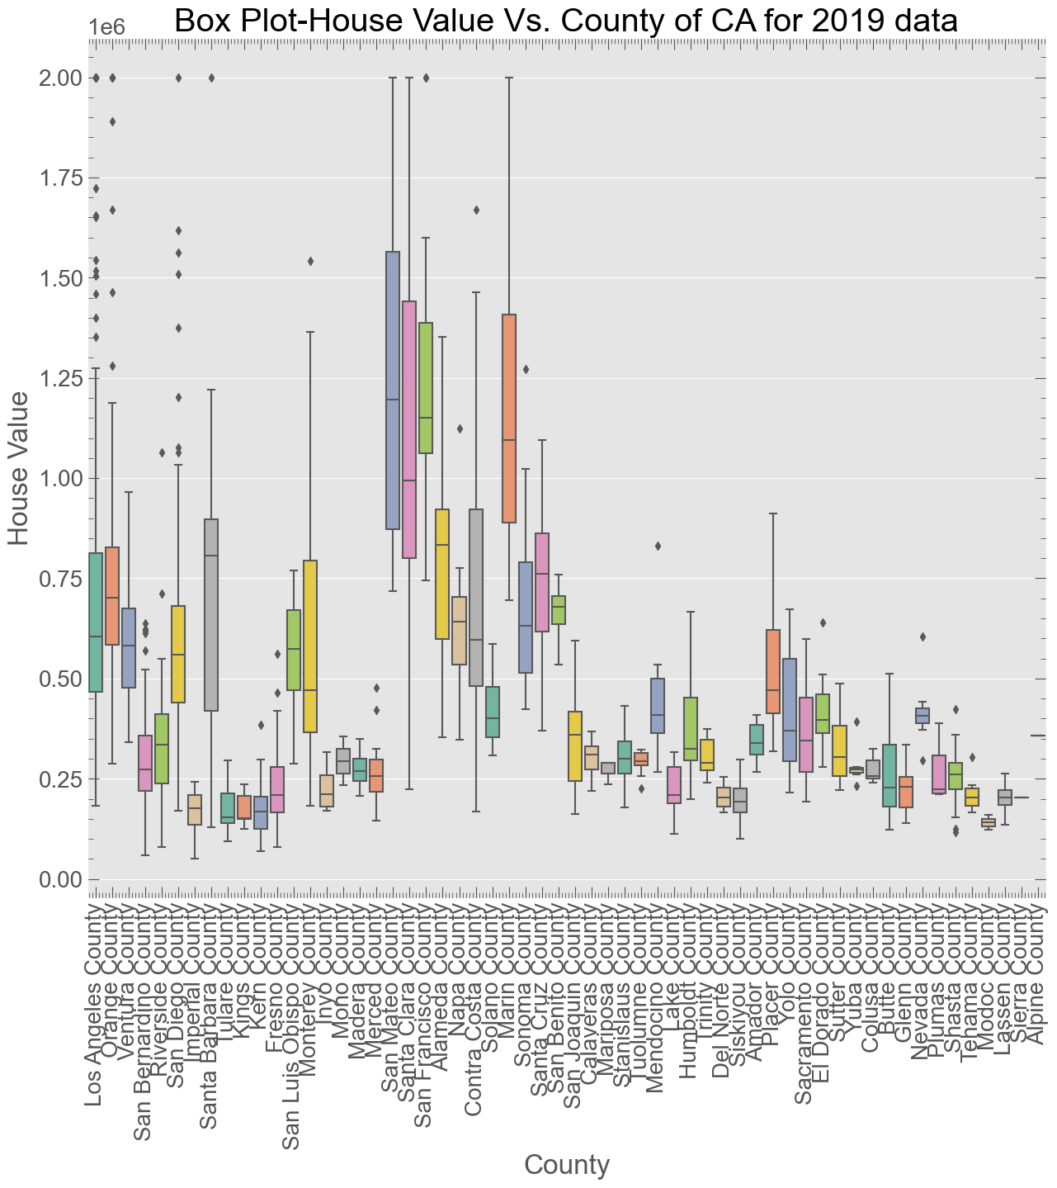
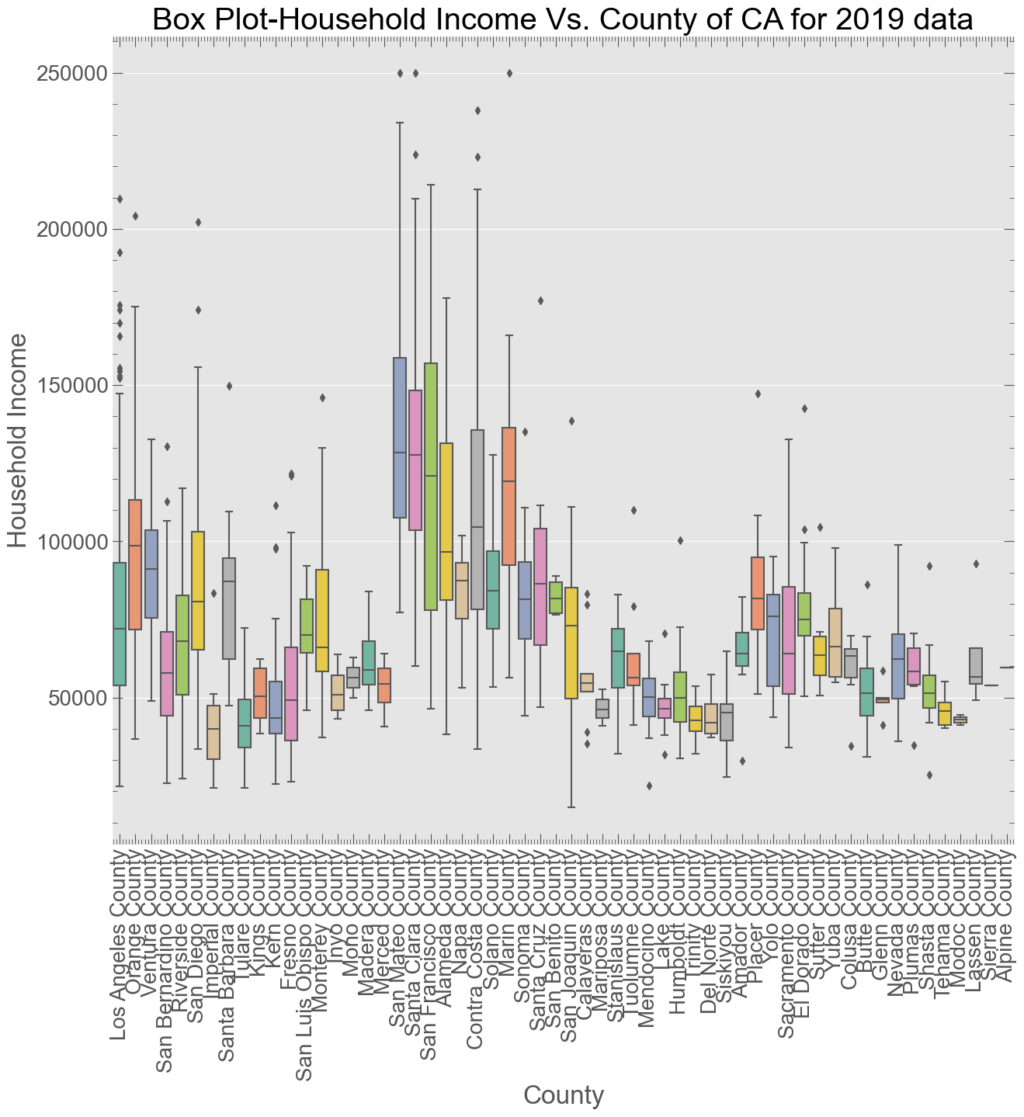

Slide 16
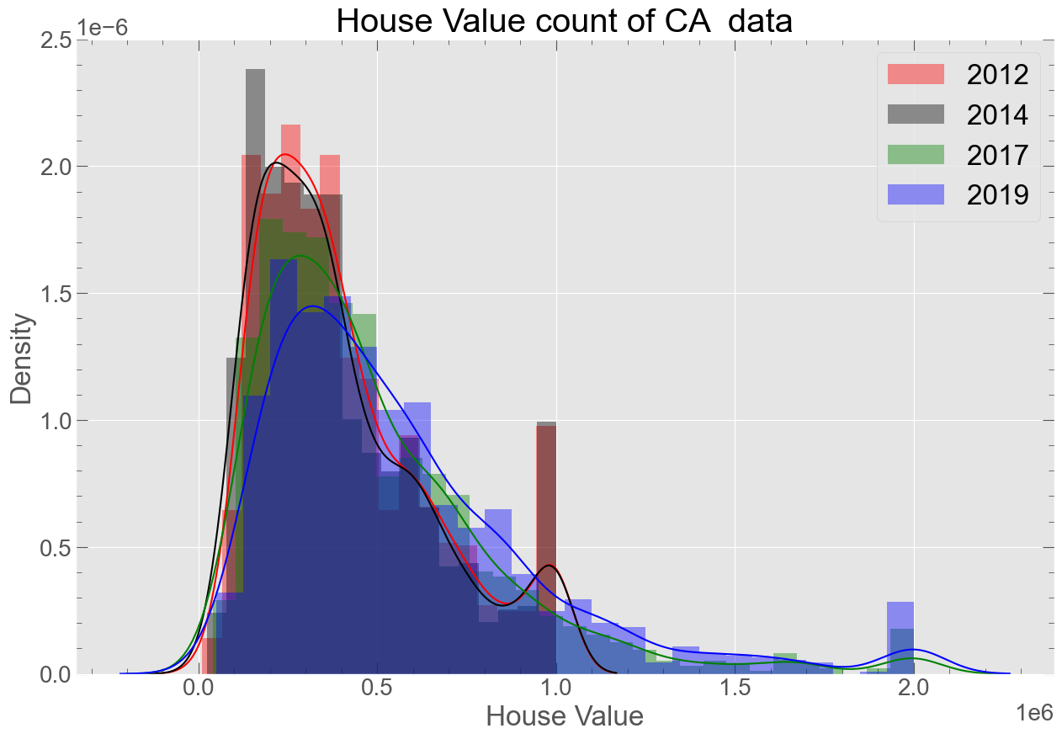
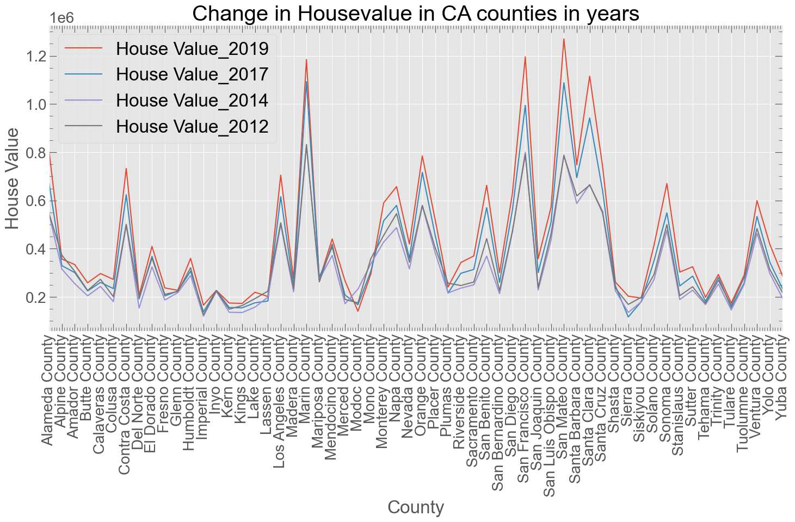
House Value for Different Years

Slide 17
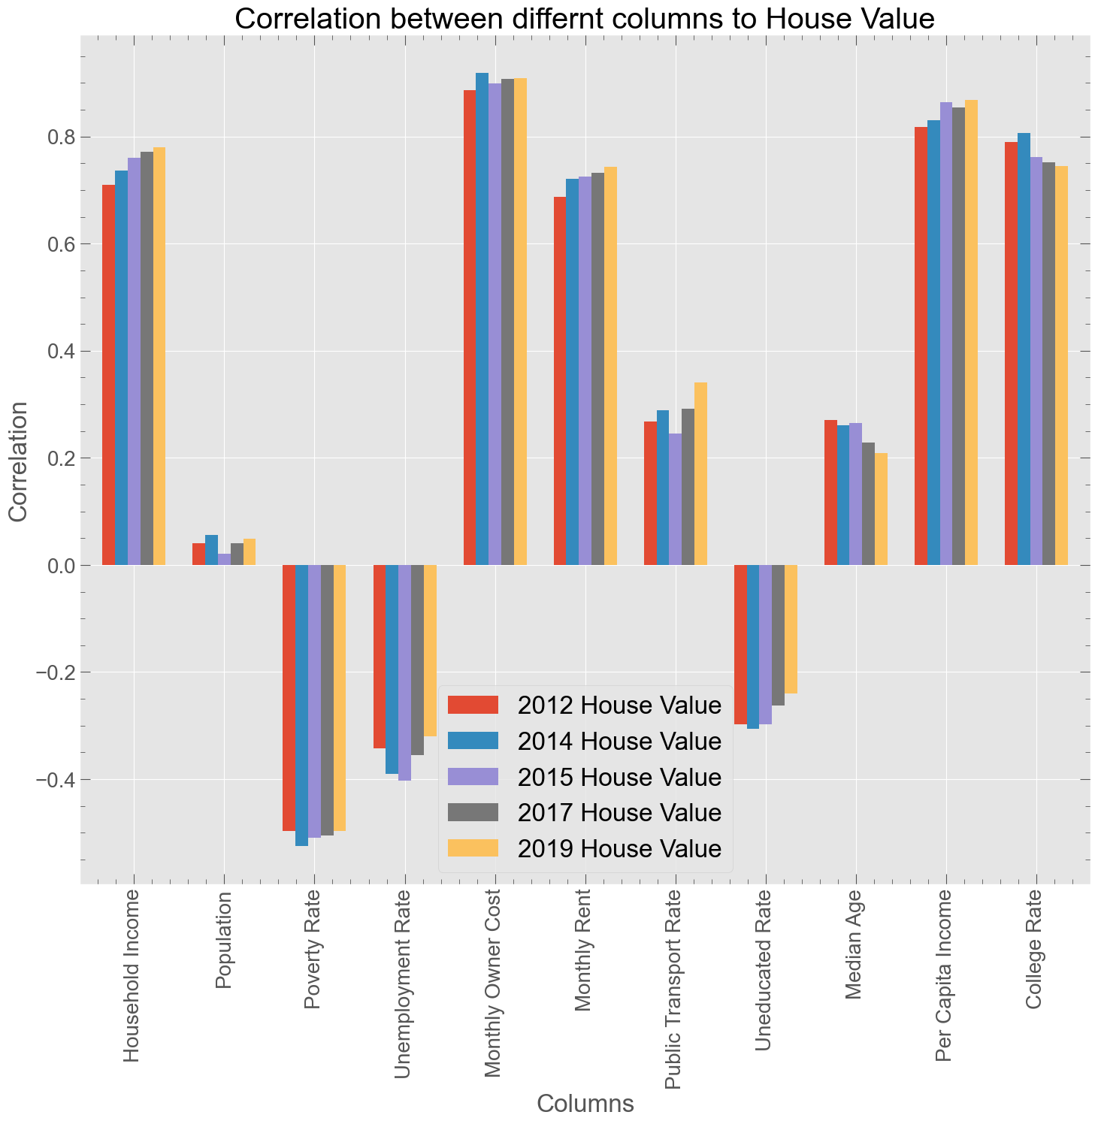
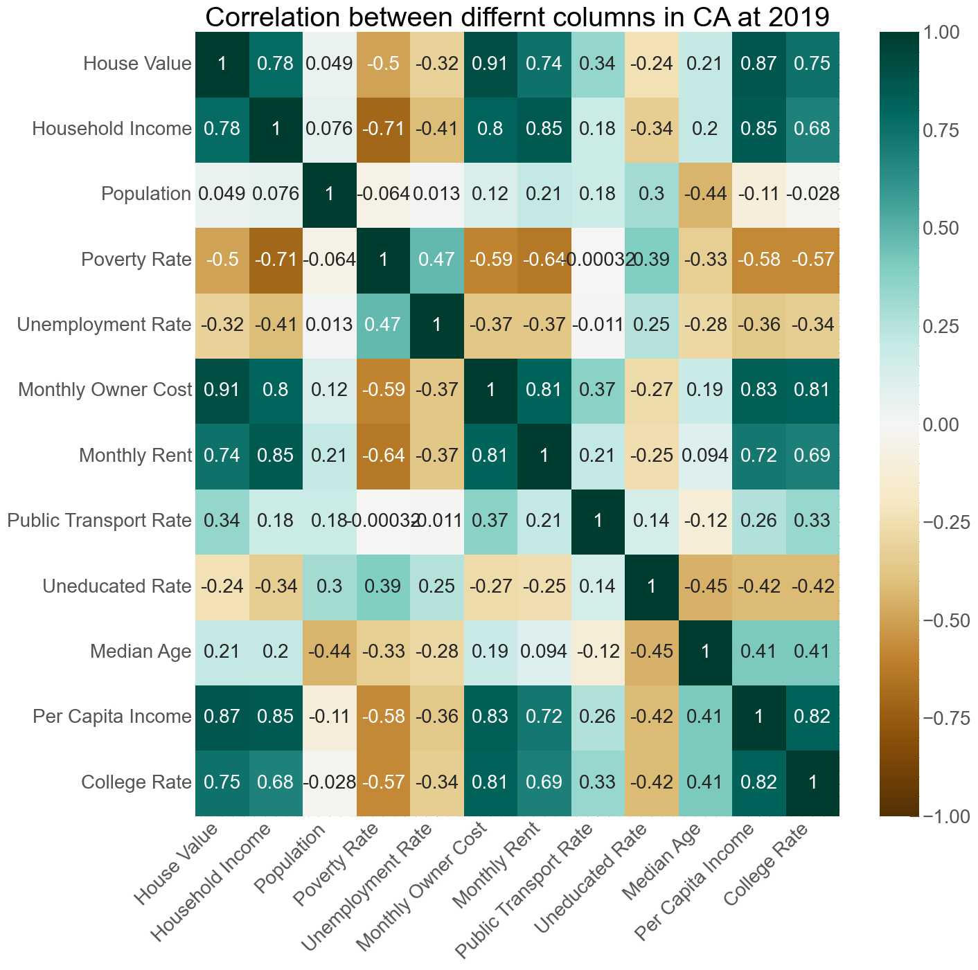
Correlation

Slide 18
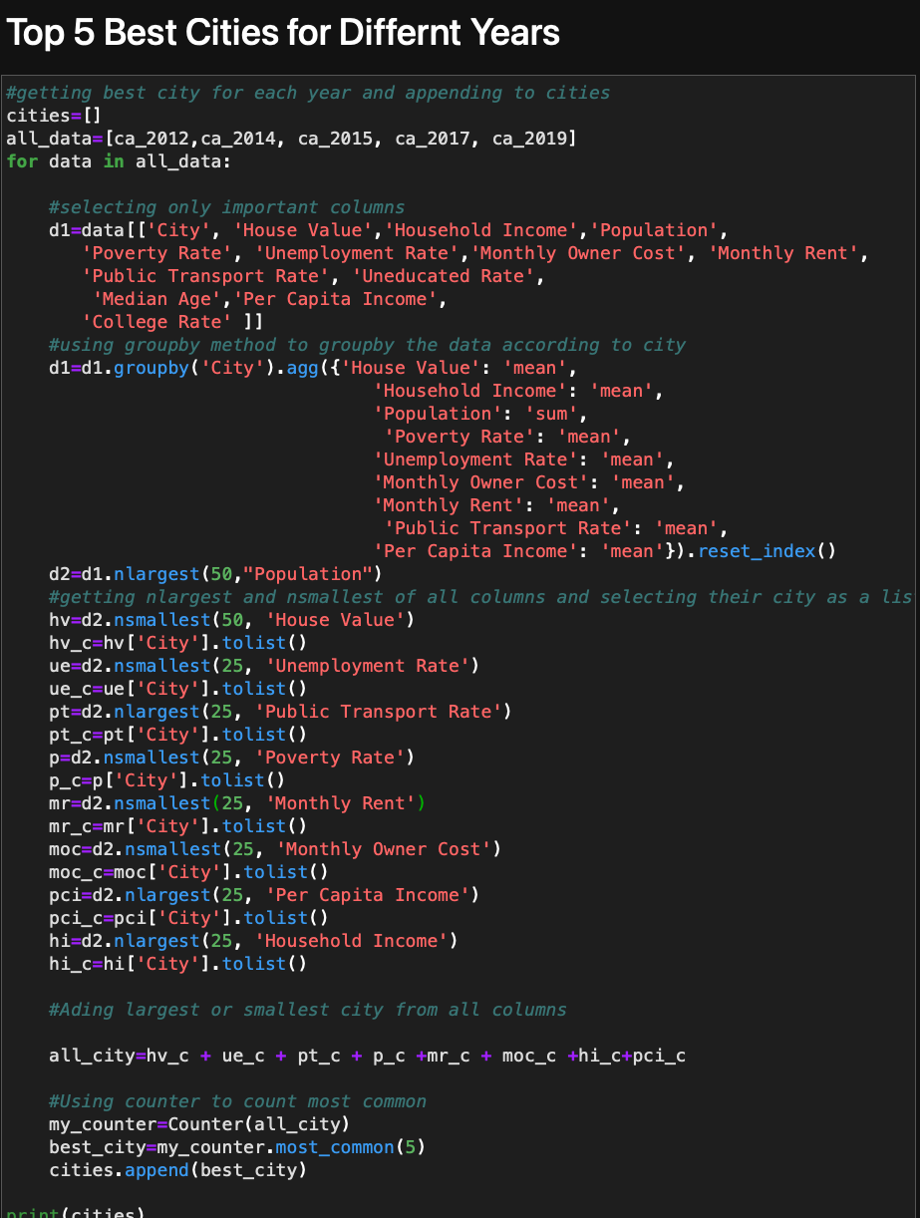
Best 5 cities
Columns:
'House Value':
'Household Income’:
'Population’:
'Poverty Rate':
'Unemployment Rate’:
'Monthly Owner Cost’:
'Monthly Rent’:
'Public Transport Rate’:
‘Uneducated Rate’:
'Per Capita Income':
We gave each parameters equal weight
Best city: which satisfy most of this parameters

Slide 19

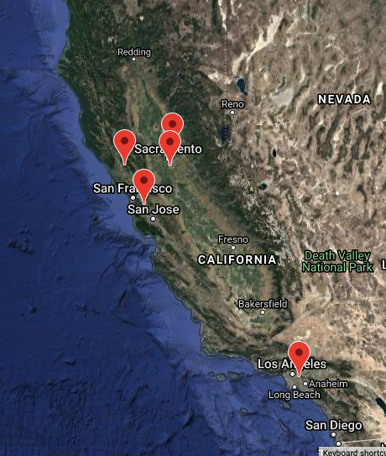
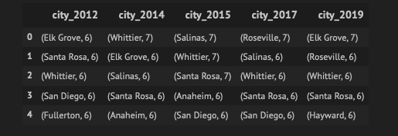
gmaps

Slide 20
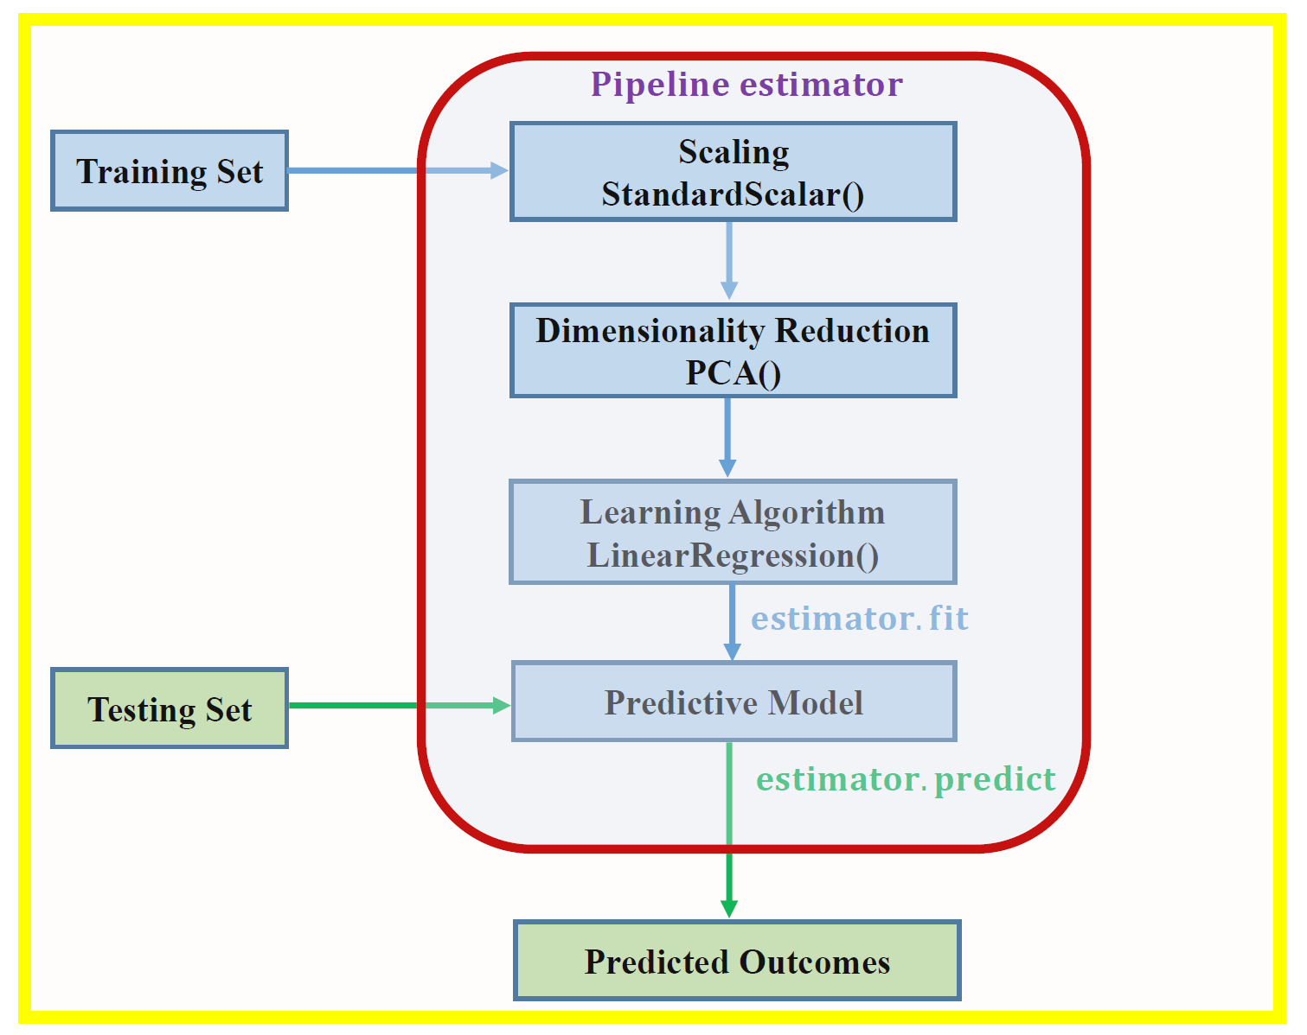
Data Modeling
Models
Linear Regression
Lasso Regression
Ridge Regression
Support Vector Machine
Decision Tree Regressor
Random Forest Regressor

Slide 21
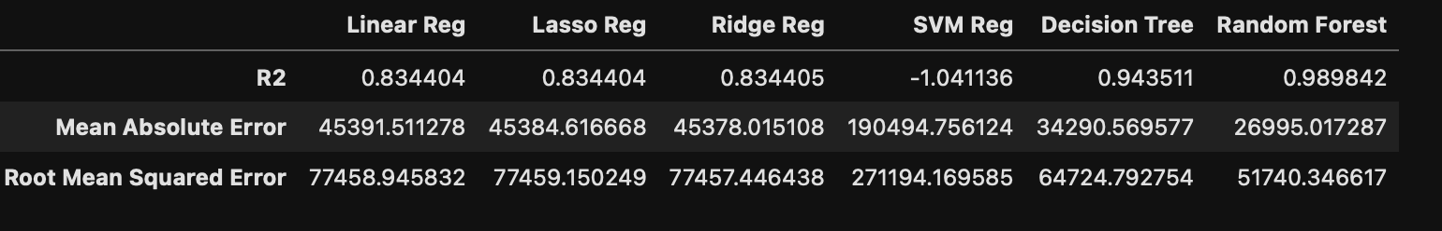
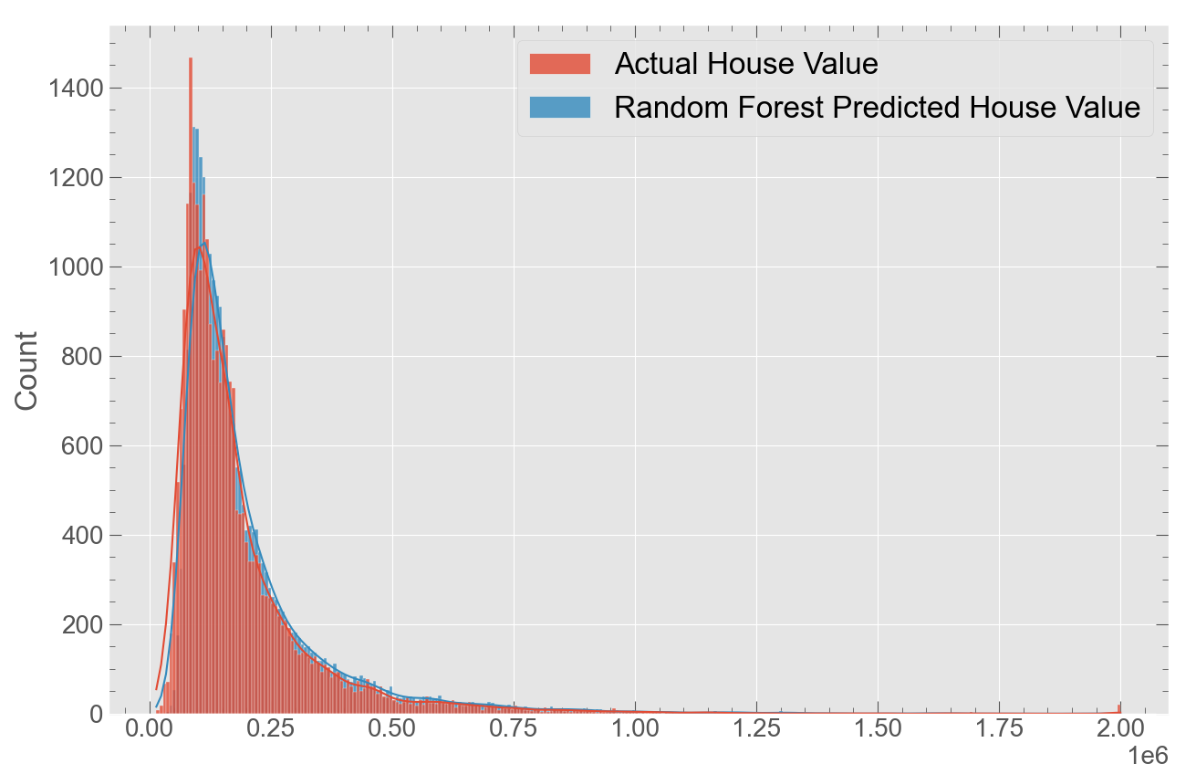
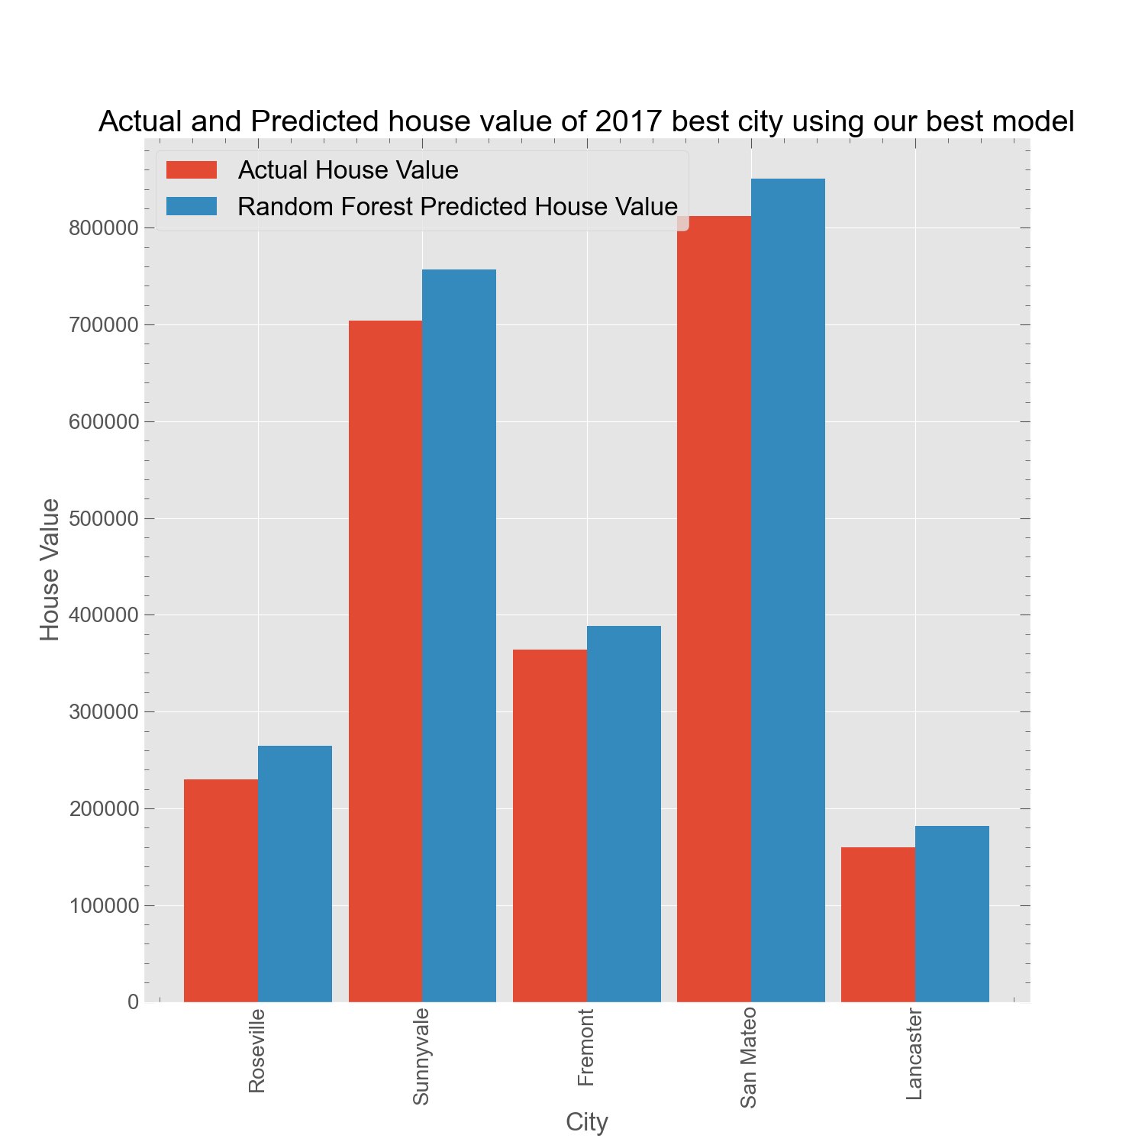
Evaluation Metrices
Our model successfully predict the housing value of unseen data from 2017 Census with an prediction error of around $27,000

Slide 22
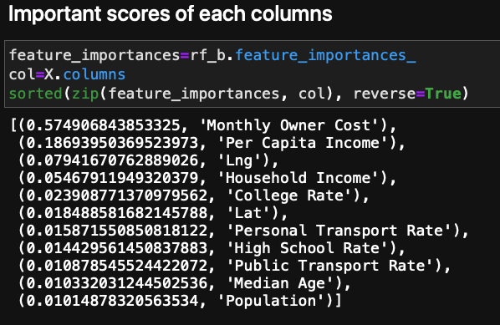
Conclusion
Used Census API to download the 5 years of US data
33000 rows
30 columns
Looked the relationship of house price to other factors
Found some interesting trend of house value on different years
Analyzed the data and recommended the best city
What parameters other cities need to improve to be the best city
Build a model to predict the house value
Our best model predict the house value perfectly with an error of around $30,000.

Slide 23

THANK YOU
Notes:
Thank you for your time and thank you for your attention
That pretty much complete my talk.

Slide 26
